Slide 1
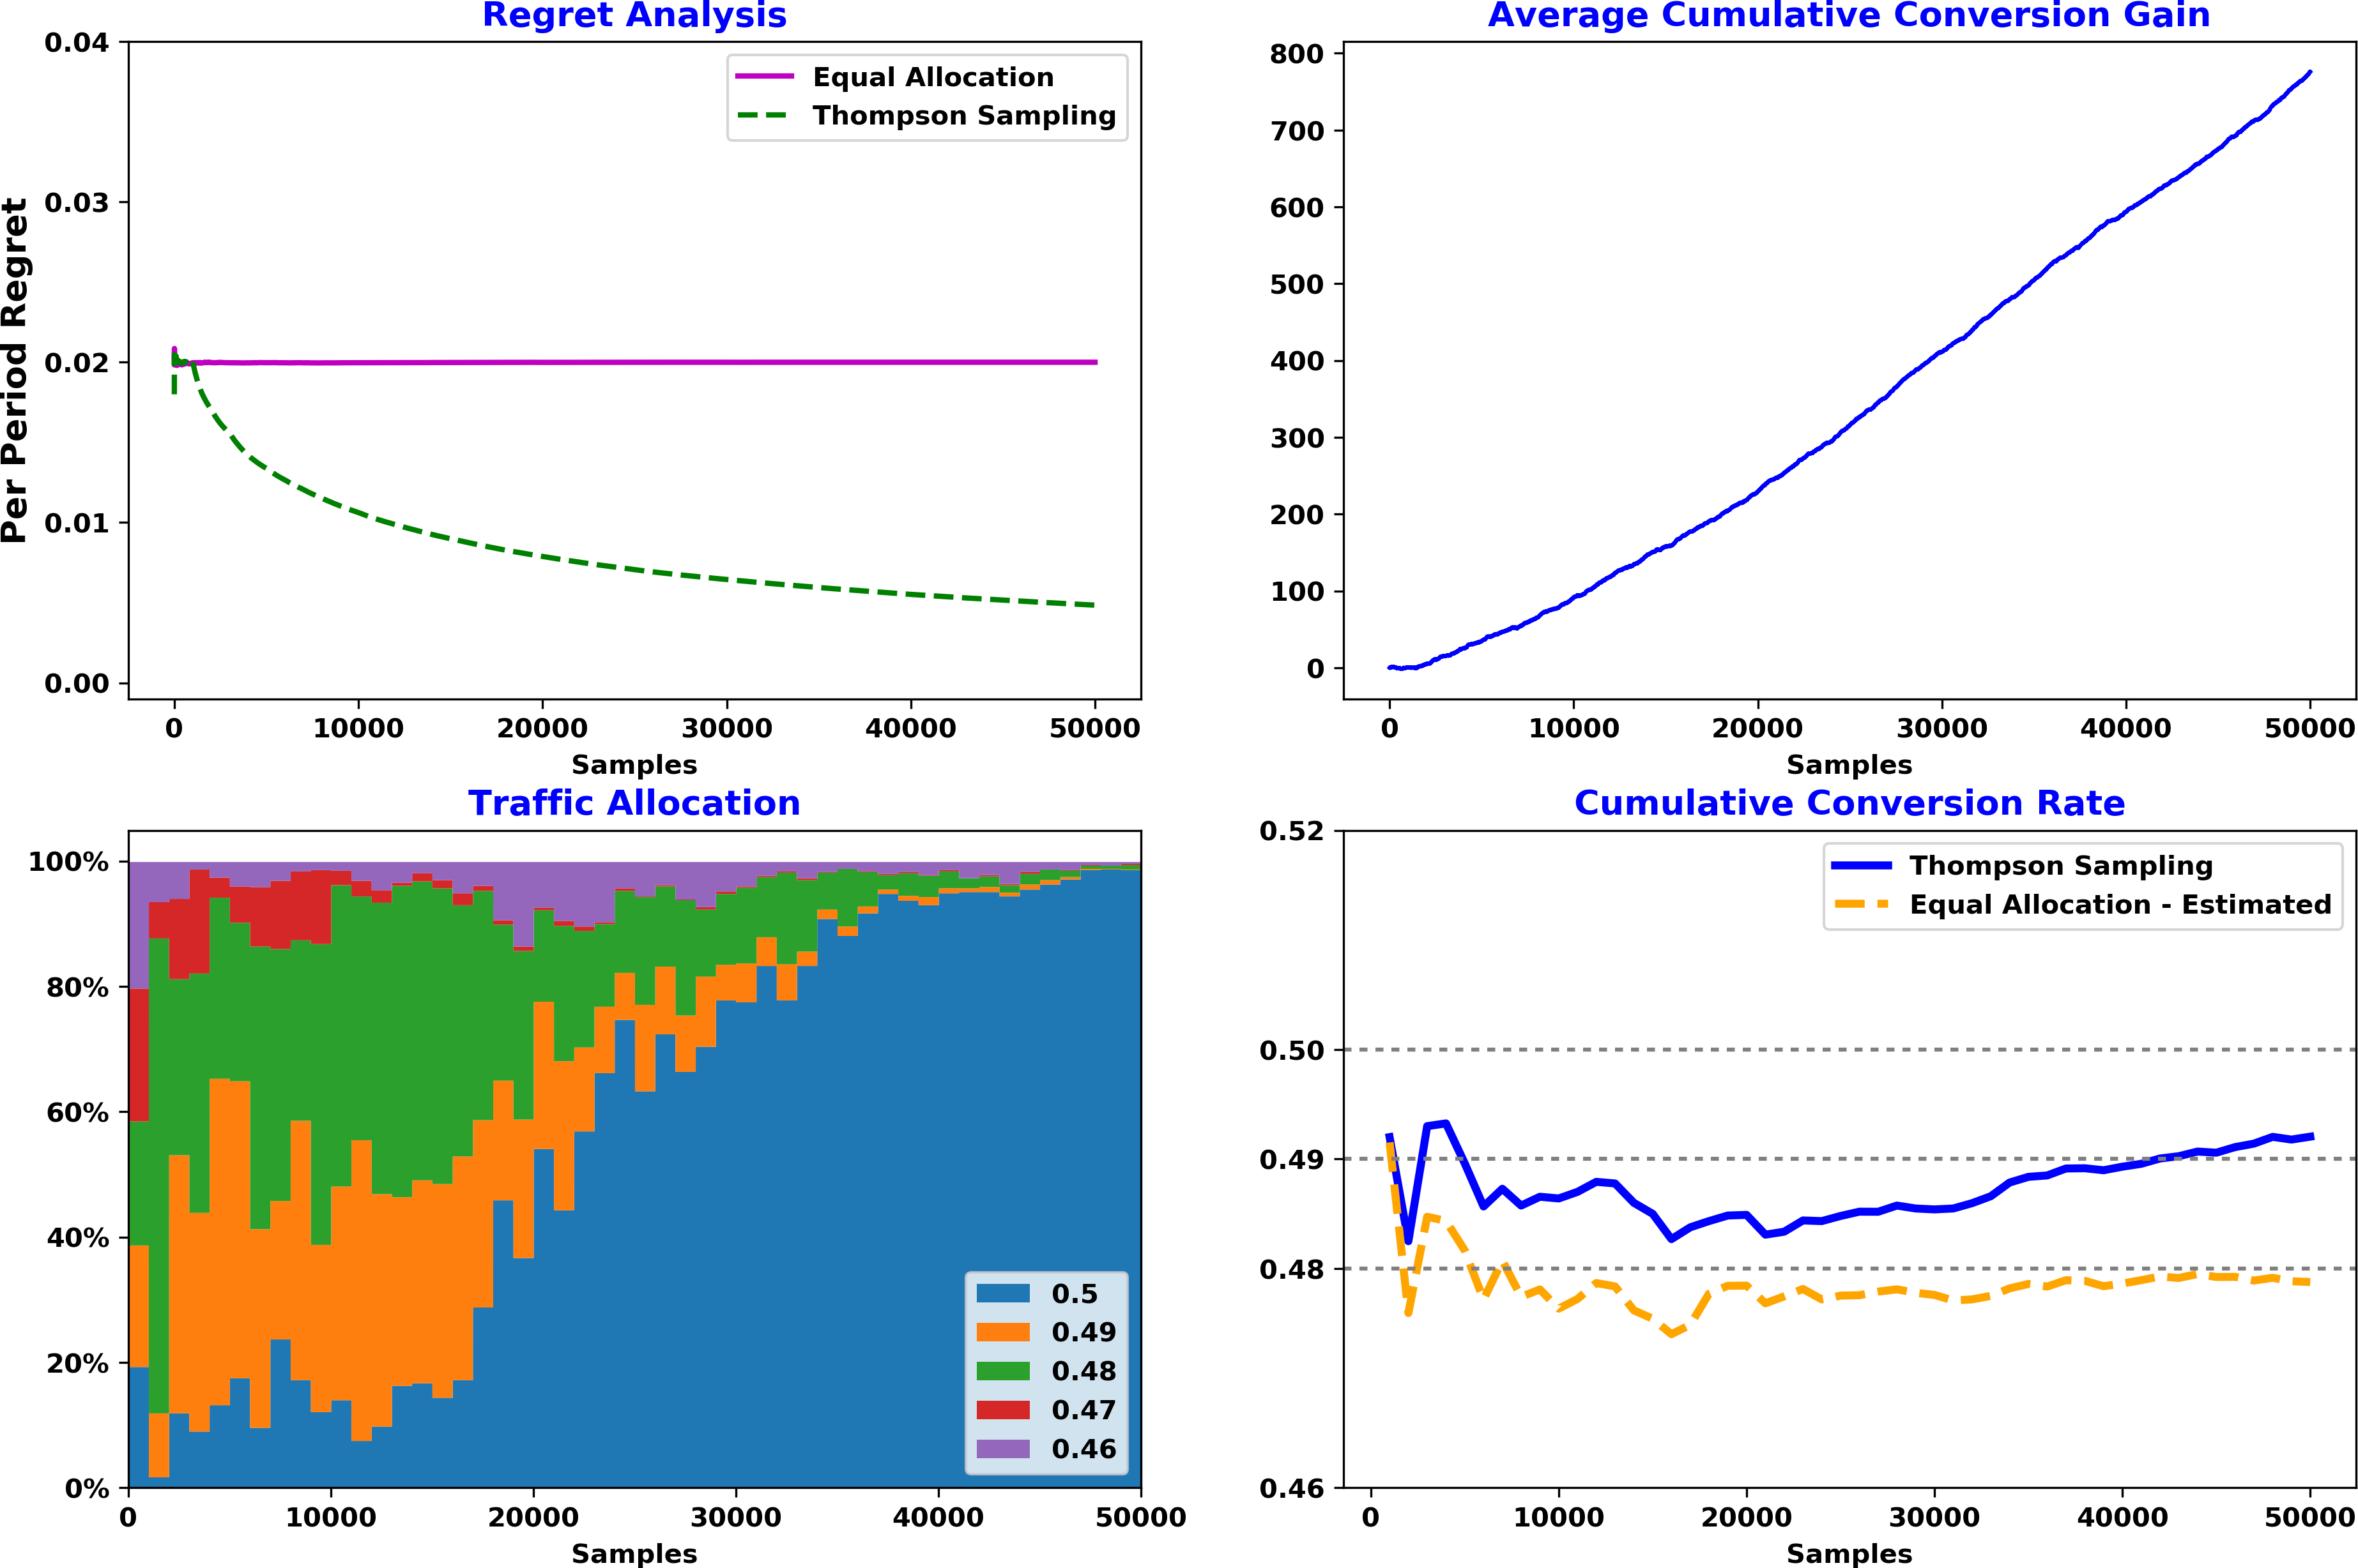
Thompson Sampling – 5 variants
Conversion rates: [0.50, 0.49, 0.48, 0.47, 0.46]

Slide 2
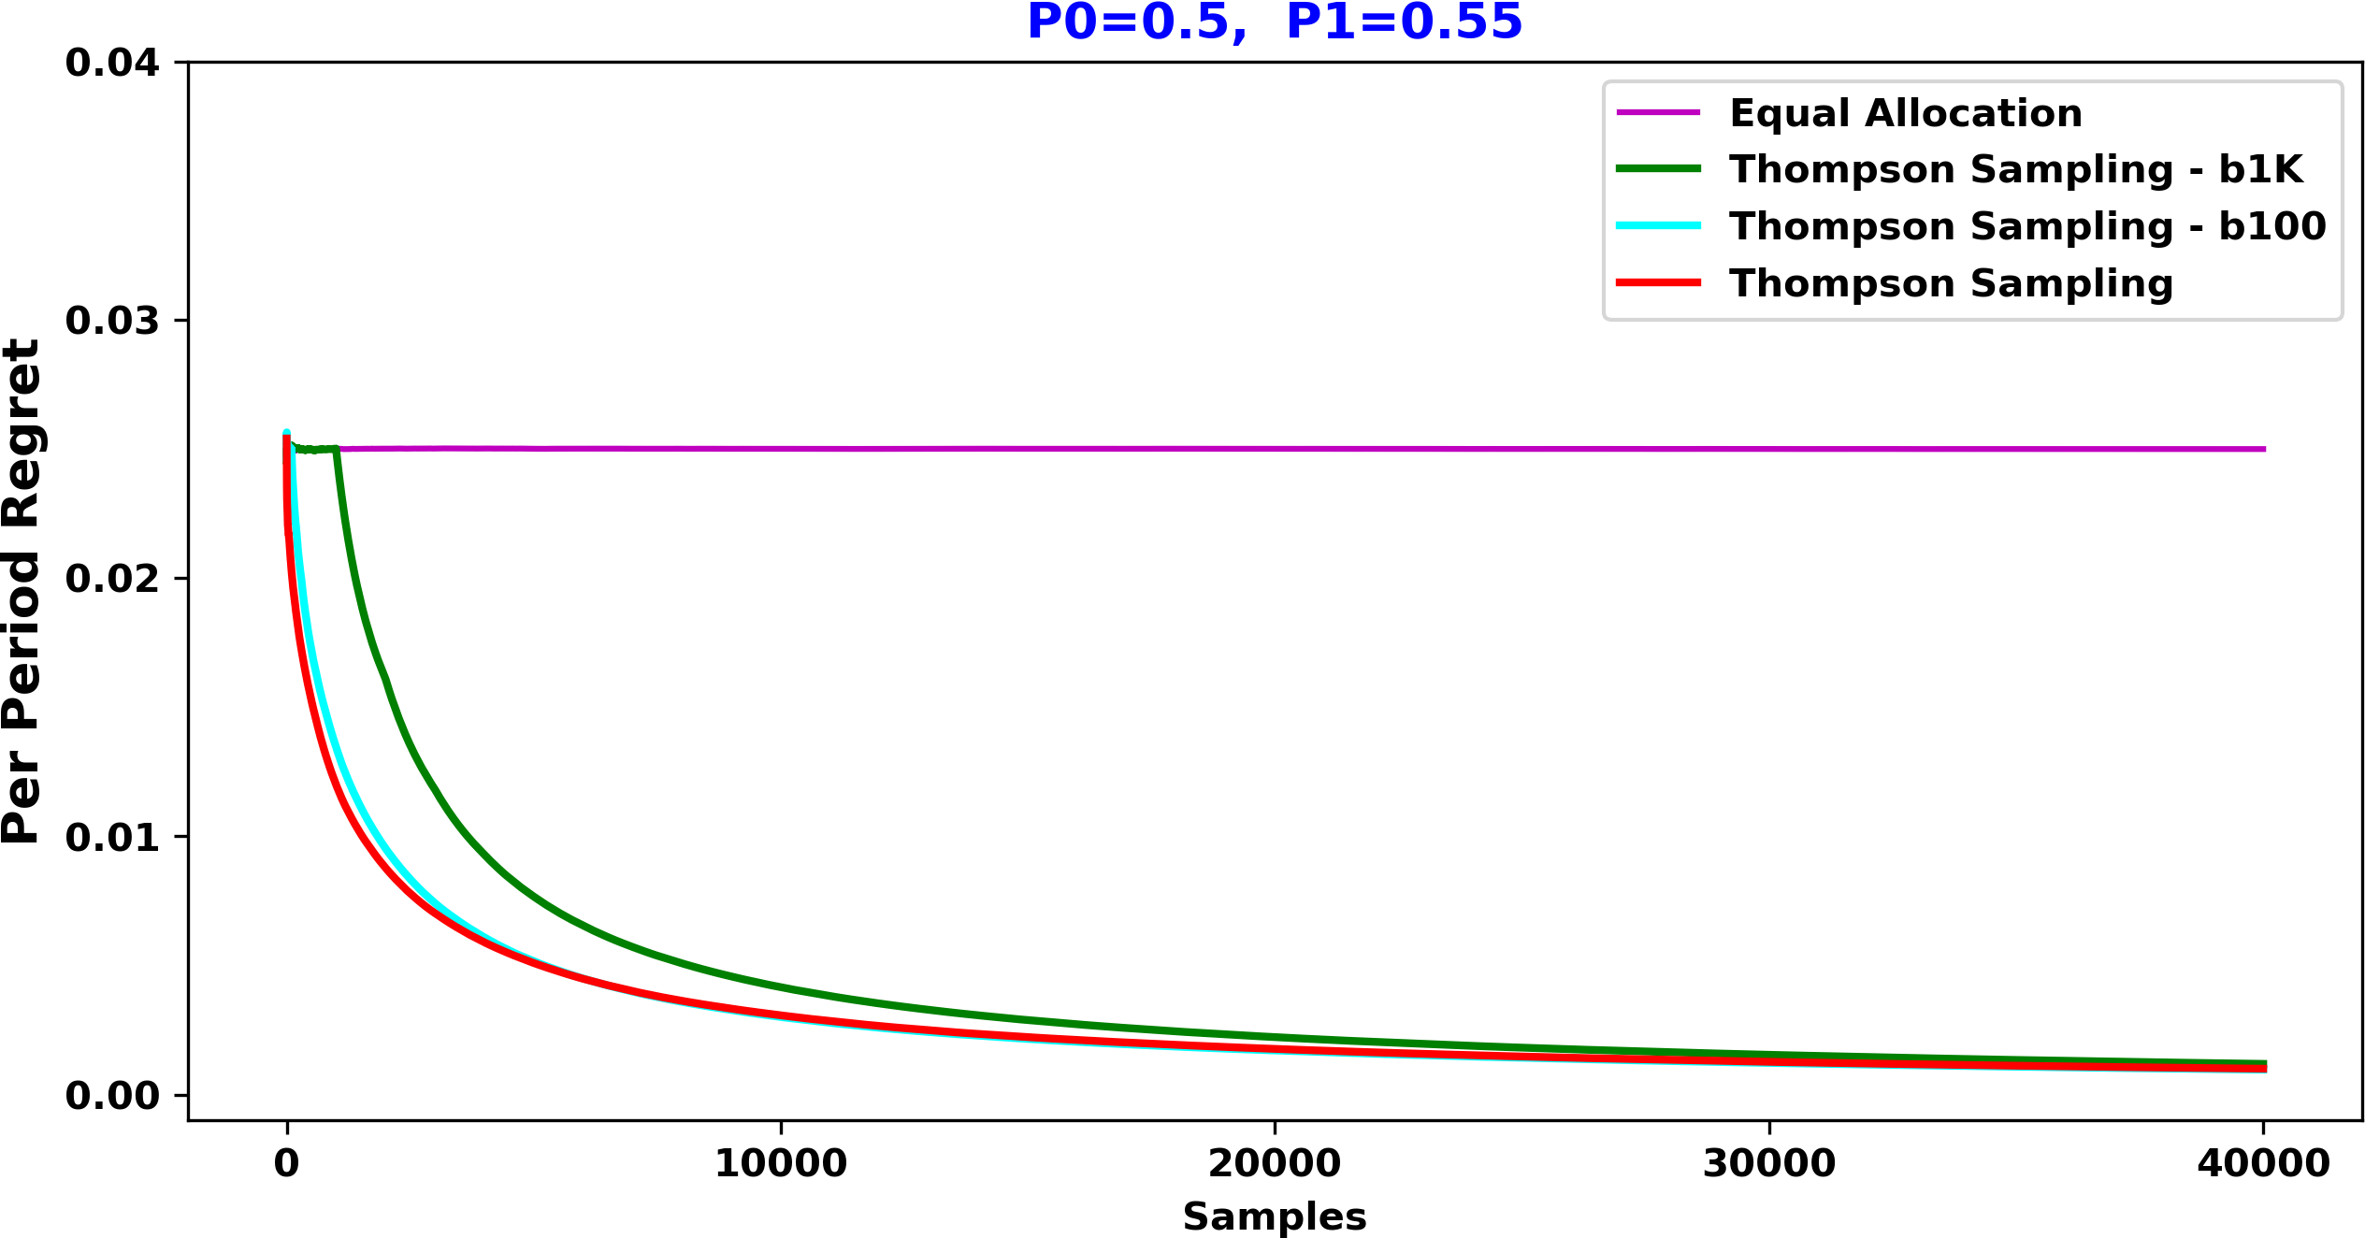
Thompson Sampling – Batch Update

Slide 3
MAB – Future Work
Time-varying conversion rates
Non-stationary algorithms
More accurate conversion gain estimate
Best arm identification algorithms
References:
[1] O. Chapelle and L. Li. An empirical evaluation of Thompson sampling.
In NIPS, 2011.

Slide 4
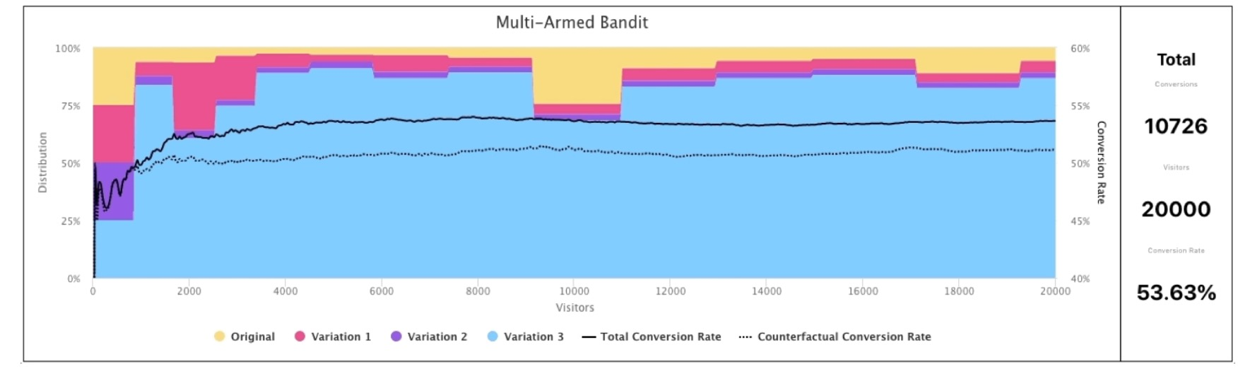
MAB – UI Considerations
Credible interval
Optimal probability(i.e. probability to be the best)
Overall conversion rate
Conversion gain estimate(compared to equal allocation)

Slide 5
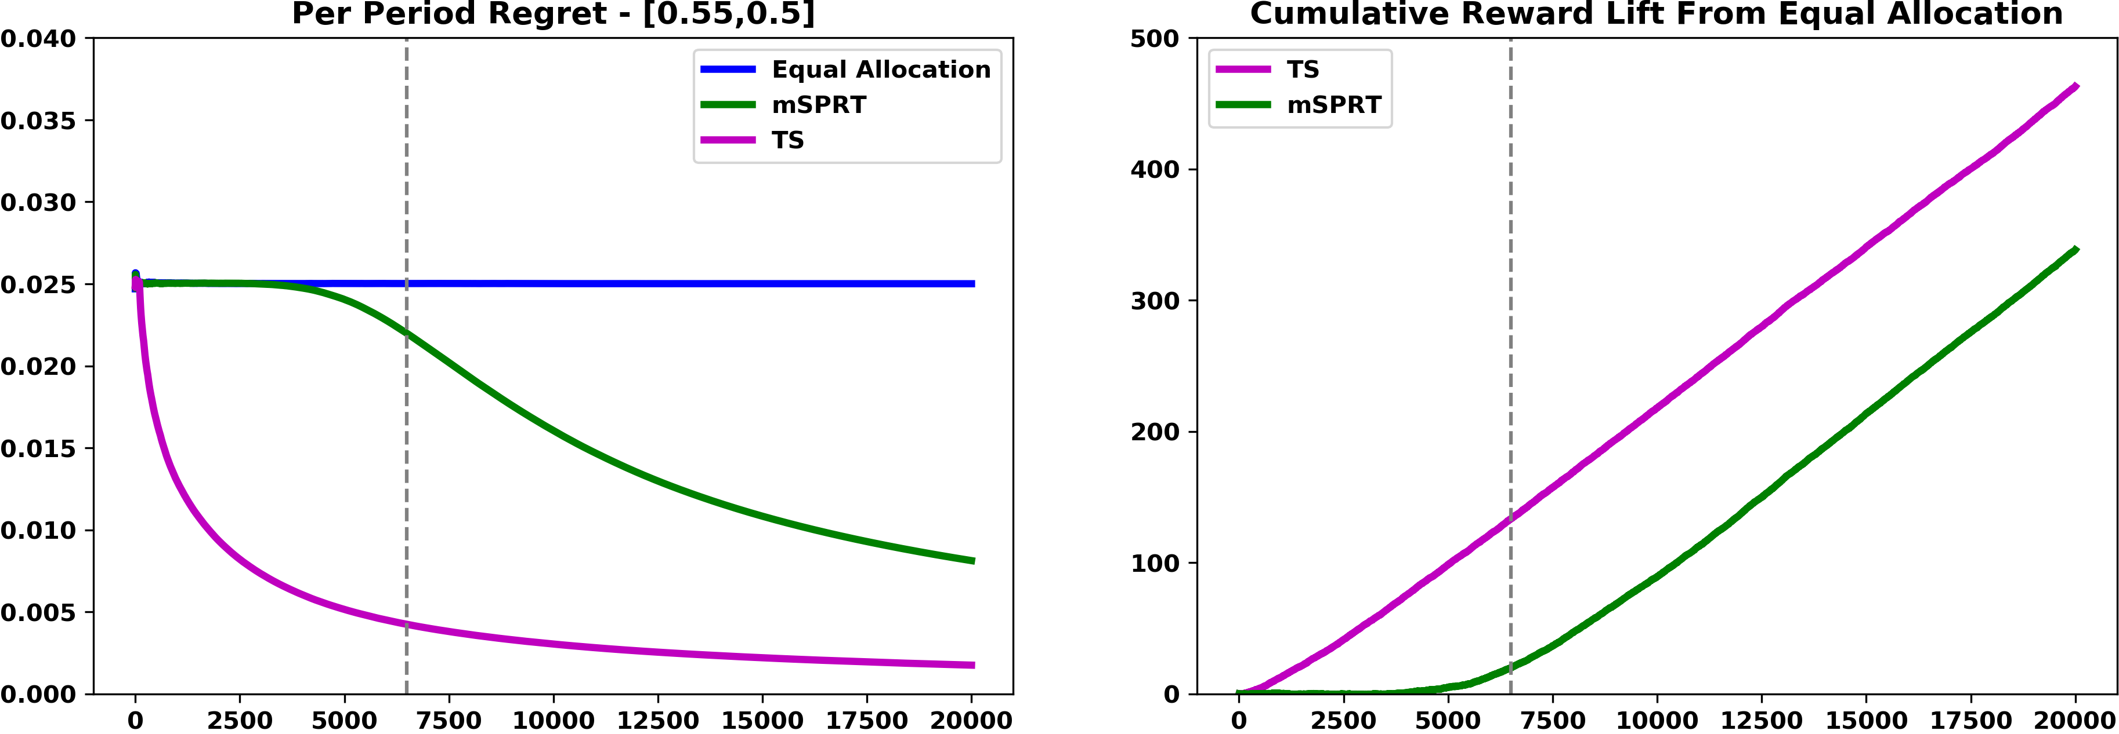
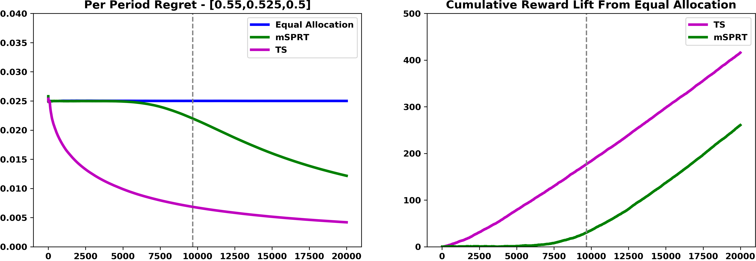
Thompson Sampling vs mSPRT

Slide 6
Non-stationary TS
Sliding Window TS
Discounted TS

